Slide 1
Новые открытия в языкознании и происхождение БИблии
ЕАД Международная Библейская Конференция
8 февраля 2023
Майкл Г. Хазел, PhD
Школа религии/Институт археологии
Южный Адвентистский университет

Slide 2
Обзор презентаций
Библия и история: Божественный способ откровения
Новый открытия в языкознании и происхождение Библии
Ассирийский кризис и избавление Иерусалима

Slide 3
Notes:
Why do we come to Scripture? We come to seek God, yes. But we also come to seek truth. We cannot seek something that we do not believe exists. Or let me state that differently. To reach a goal, you must believe that the goal is attainable. Faith is required for the race of life that Paul speaks of. But the race is not an imaginary thing. Nor can it go endlessly in circles. It must have a direction. The race of faith is based on real life circumstances. It is set in a historical reality and the nexus of time and place. This is what makes Biblical faith unique among the ancient and modern religious/philosophical models. The Bible is constituted in a historical living reality of life as experienced and recorded through the history of this world. From Adam to the promised Messiah, from the Resurrection, which we celebrated a few weeks ago, to the Second coming. Biblical faith has a purpose, a goal, and a mission. It is forward moving. It is based on a God who is not distant and removed, but one who spoke and then formed man from the dust of the ground and breathed into Him the breath of life. A God who intricately fashioned Eve and provided for the first partnership in human history. It is based on a God who sent His son into this world. The ultimate act in human history was that act of infinite love that poured out a life to give life. This is why we can have hope. This is why we can have peace in the midst of the storm. Jesus said, in John 16:33: “These things I have spoken to you, so that in Me you may have peace. In the world you have tribulation, but take courage; I have overcome the world.”
So How then did we end up with the Bibles we read today? How did the 35-40 writers of Scripture become those writes and how did their books come to form the collection that we have today? How do the Bibles we read relate to what Moses, David, Solomon or any other person wrote? What was the process involved?

Slide 4
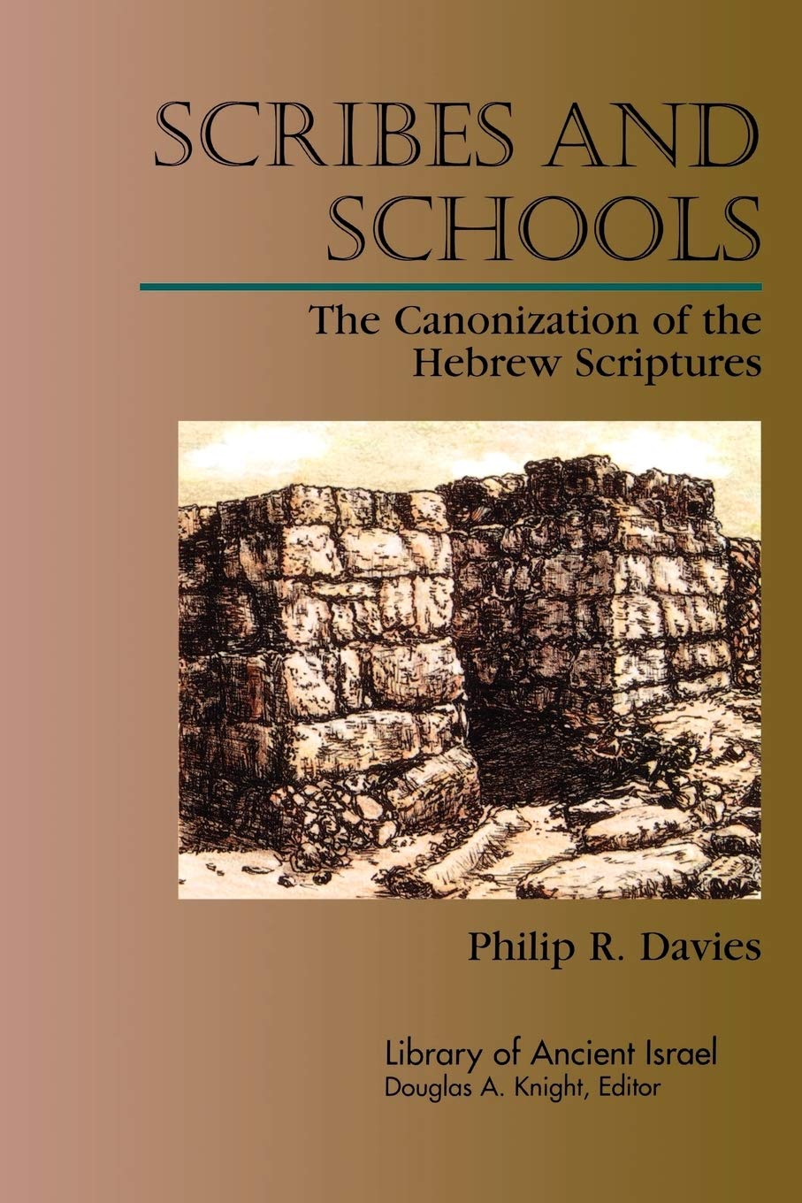
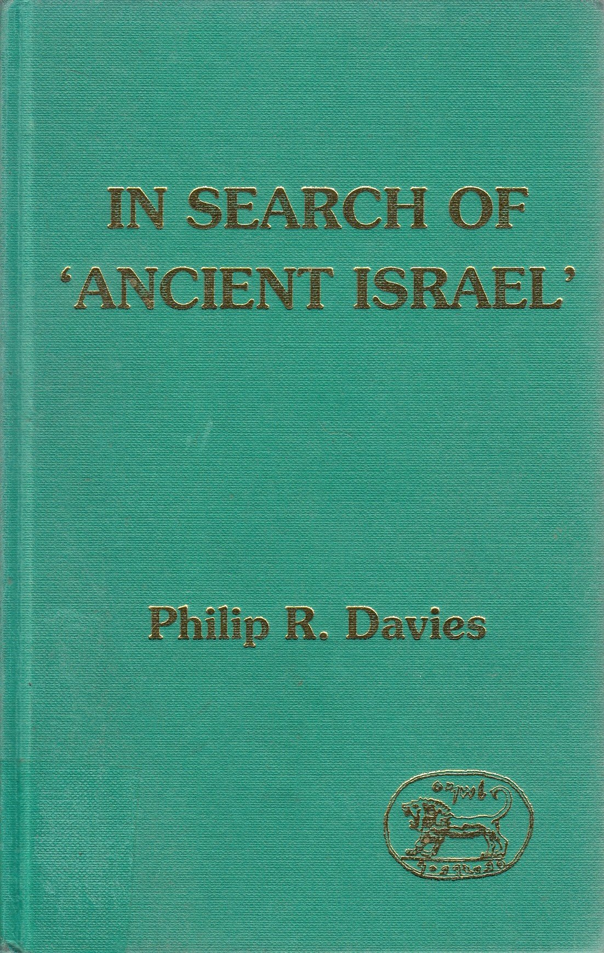
«‘Библейский еврейский’ — еще одно научное предположение; по сути, мы могли бы сказать, что это не более чем условный язык созданного учеными ‘древнего Израиля’ и таким образом часть более масштабной фальсификации» (С.104-105).

Slide 5
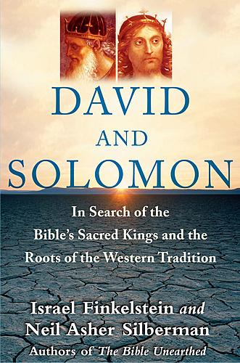
►Нет свидетельств обширного заселения внутренних районов
►Нет свидетельств крупных строений/фортификаций
►Нет свидетельств, что Иерусалим был крупным городом
►Нет свидетельств, что грамотность была широко распространена
►Нет свидетельств масштабных войн

Slide 6
Gezer
●
Azekah
Kh Qeiyafa
●
●
Socoh
Zayit
Kh. el-Rai
Kh. Summeily
●
●

Slide 7
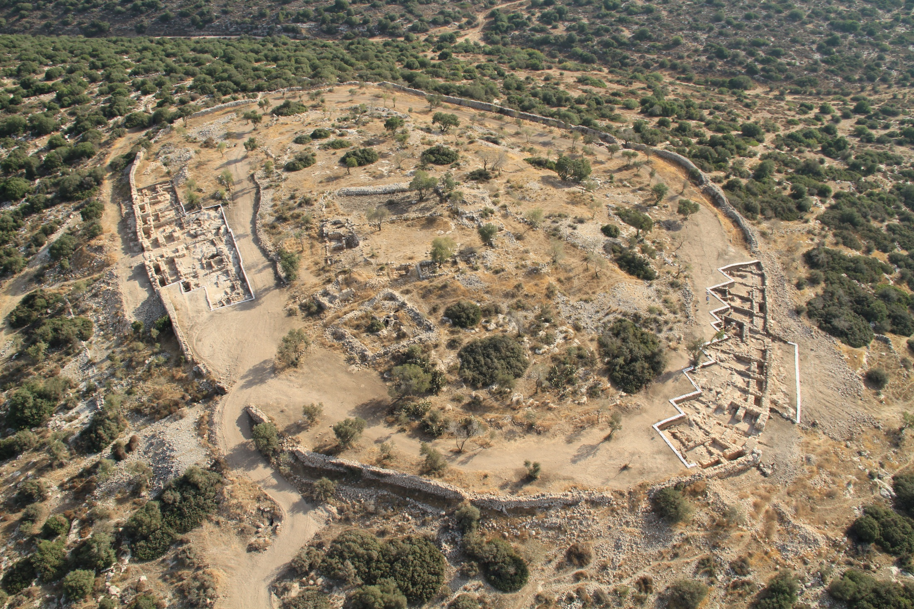

Slide 8






Slide 9
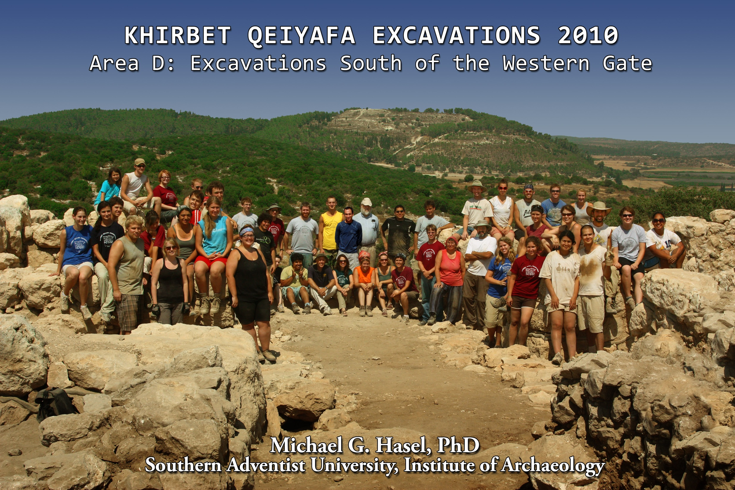

Slide 10
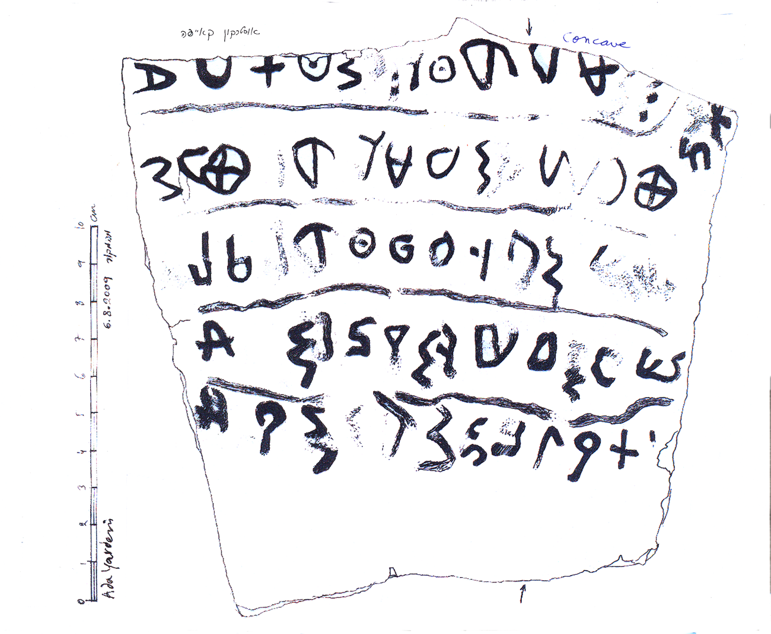

Slide 11
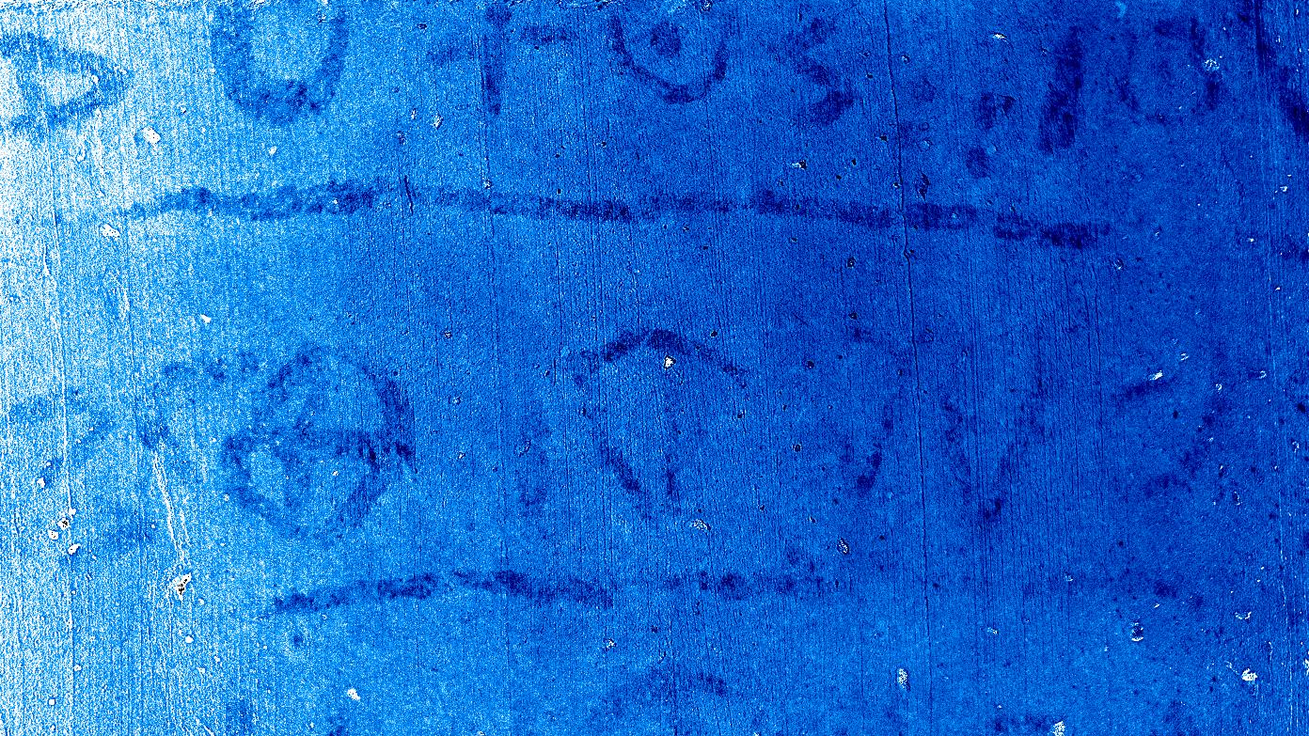

Slide 12
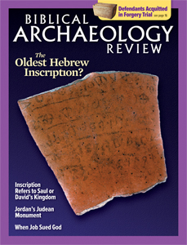

Slide 13
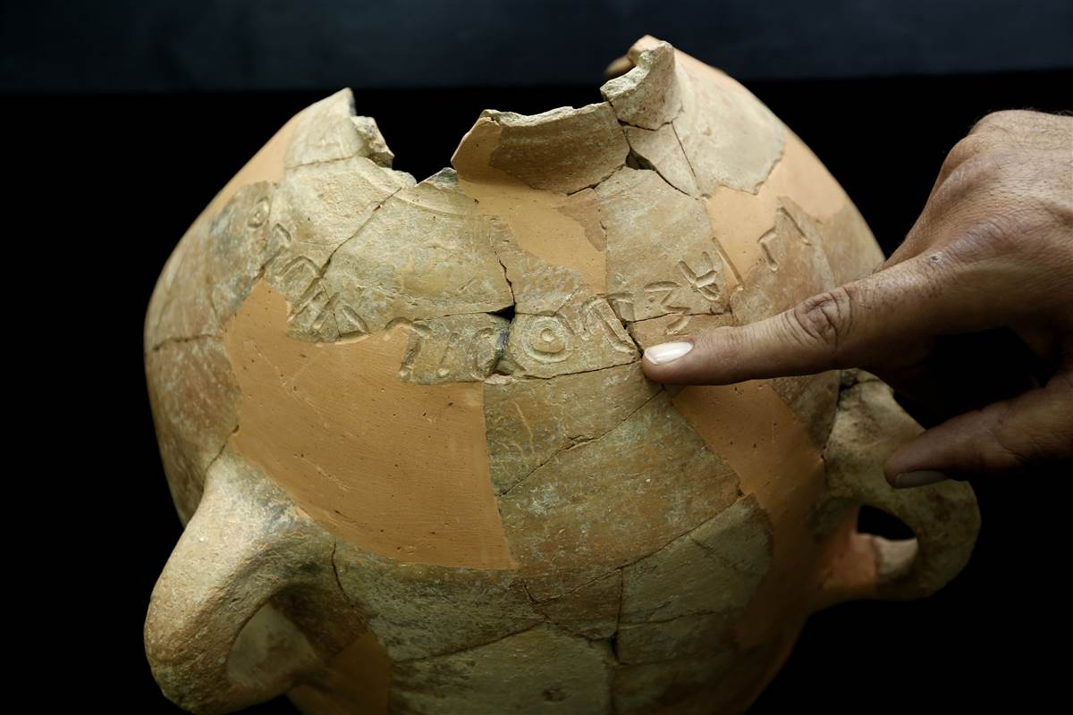

Slide 14
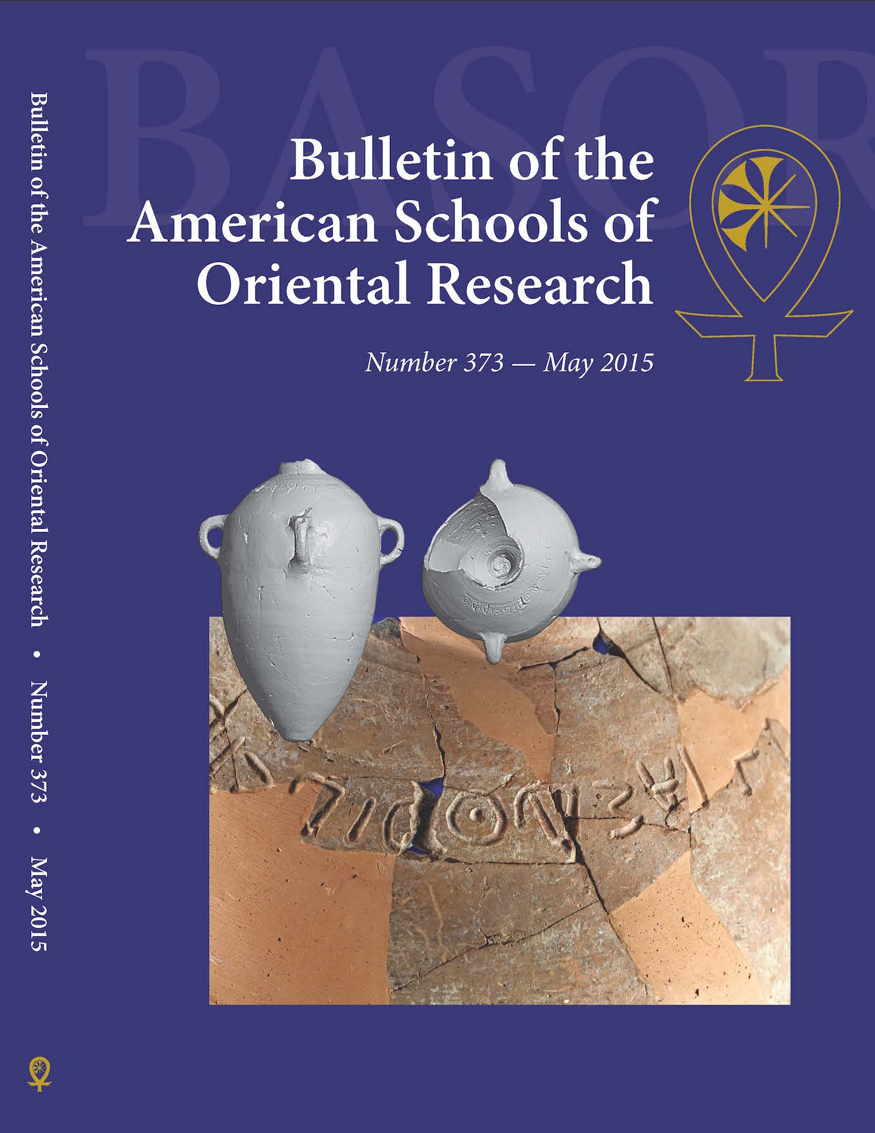

Slide 15
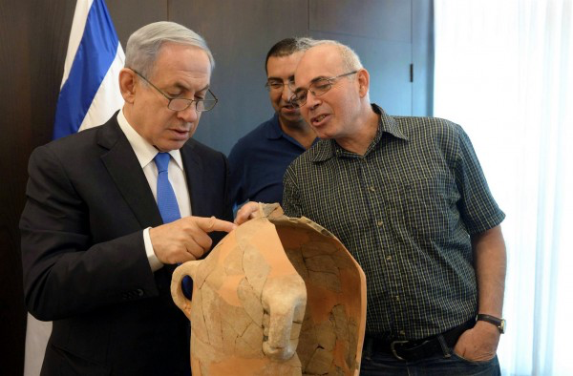

Slide 16
Gezer
●
Azekah
Kh Qeiyafa
●
●
Socoh
Zayit
Kh. el-Rai
Kh. Summeily
●
●

Slide 17
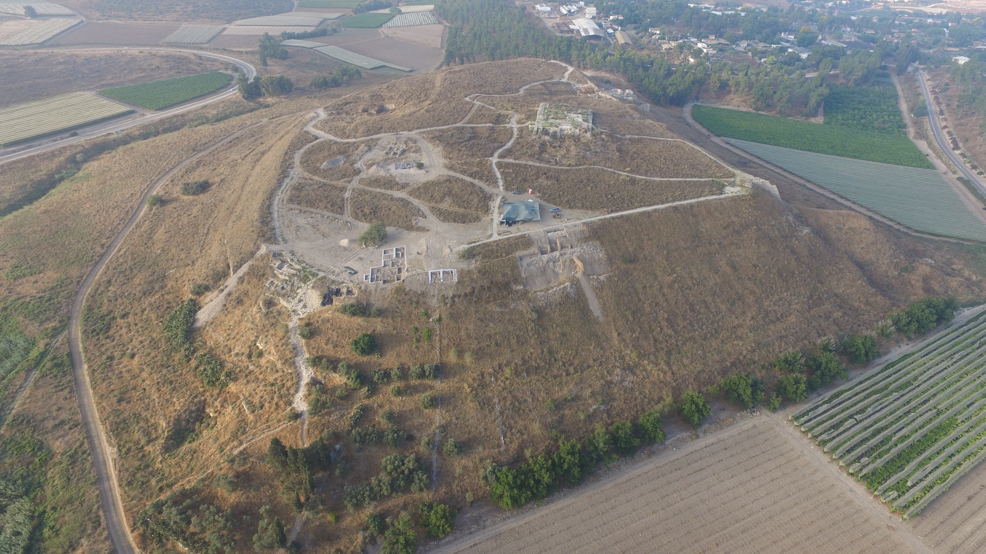

Slide 18
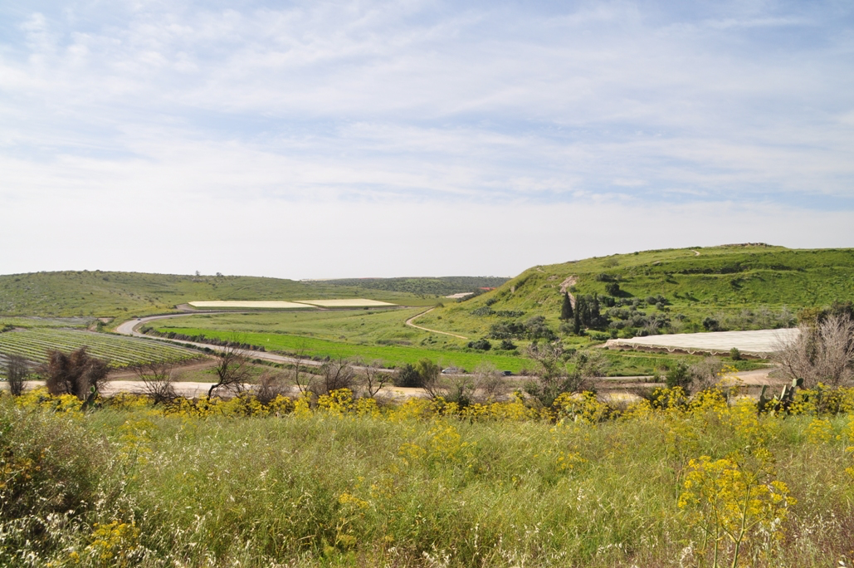

Slide 19

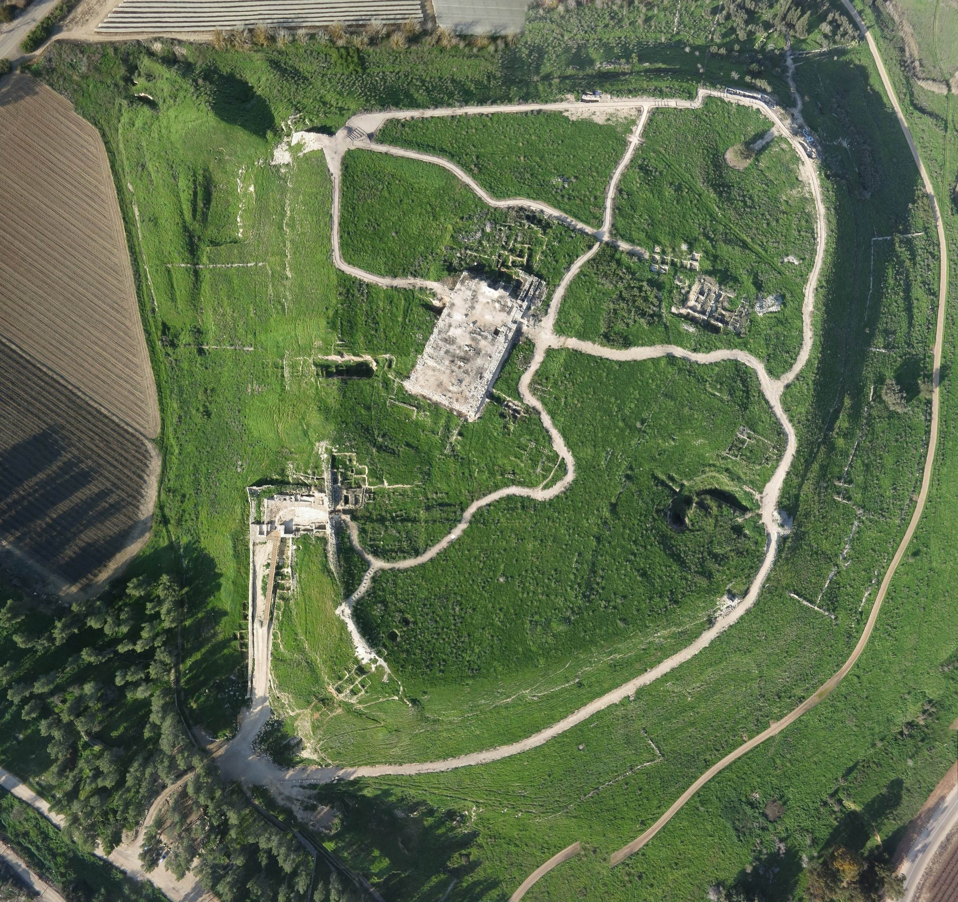

Slide 20
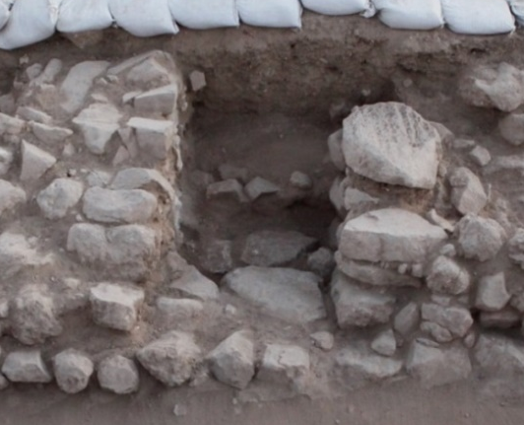
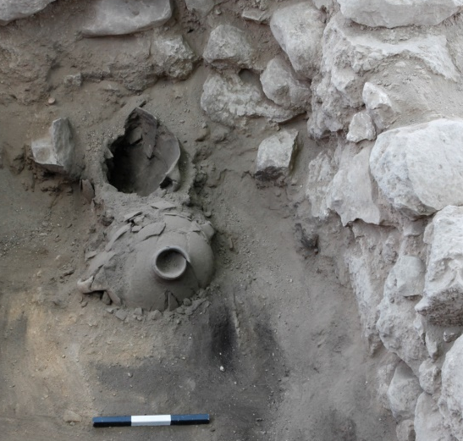
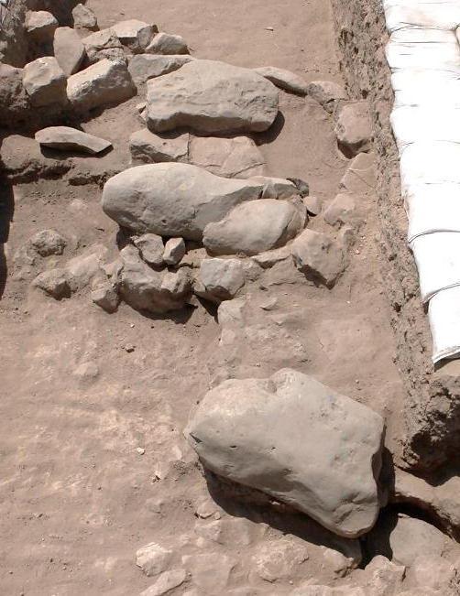
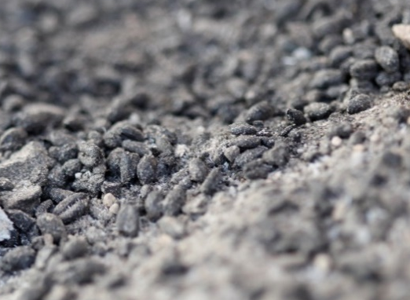
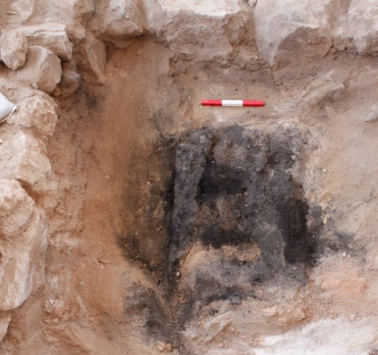
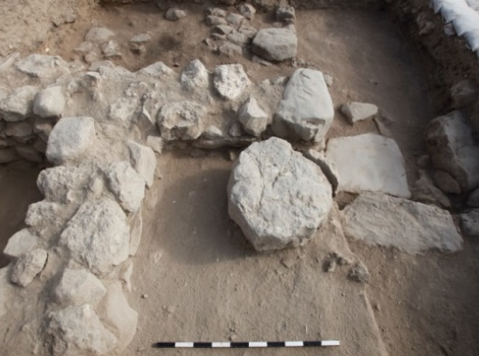
Северо-восточный храм
Вход
Notes:
The plan of the North-East Temple includes…
*(KLIK) A main entrance, that in the past was flanked by two pillars.
- From those only the west one was found in-situ.
*(KLIK) To the left of the entrance theirs a room, that was divided in to two parts.
- Its seem to be a tower. And based on parallels, we suggest the existent of a second such tower also to the right of the entrance.
*(KLIK) The entrance leads to the main hall of the temple,
- which initially seem to includes four pillars, from which only three bases were found.
* In the right side of the hall there's a stone platform, that include a basin (here in grin)
- and an installation with three fallen "Standing Stones" (in red).
*(KLIK) To the west of the hall, there are two side rooms.
* The northern room seems to be used for storage,
* and the southern room used as a granary,
- in which a large wooden box full of seeds was found.
*(KLIK) To the east of the hall. There was another room,
- but from it only the foundations were preserved.
*(KLIK) in the north, there's an entrance to the Holy-Of-Holies
- a room, or some cult niche -
- That was almost completely eroded by the slope of the mound.

Slide 21
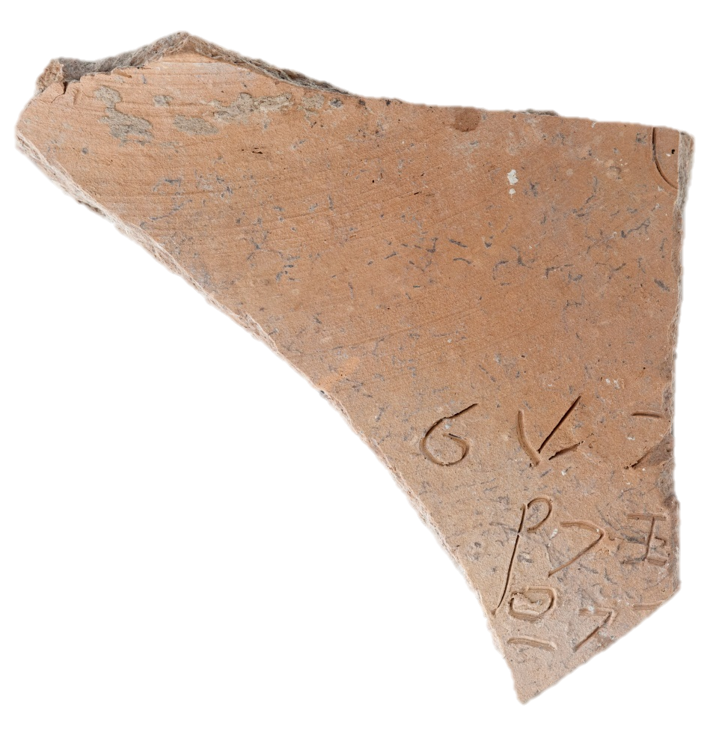
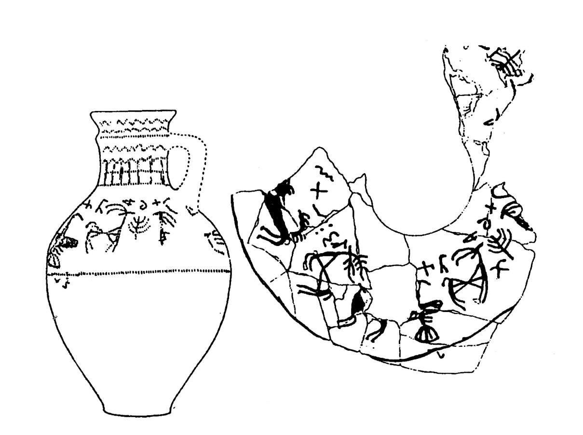
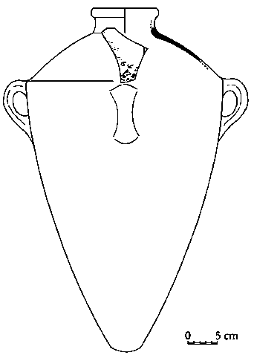
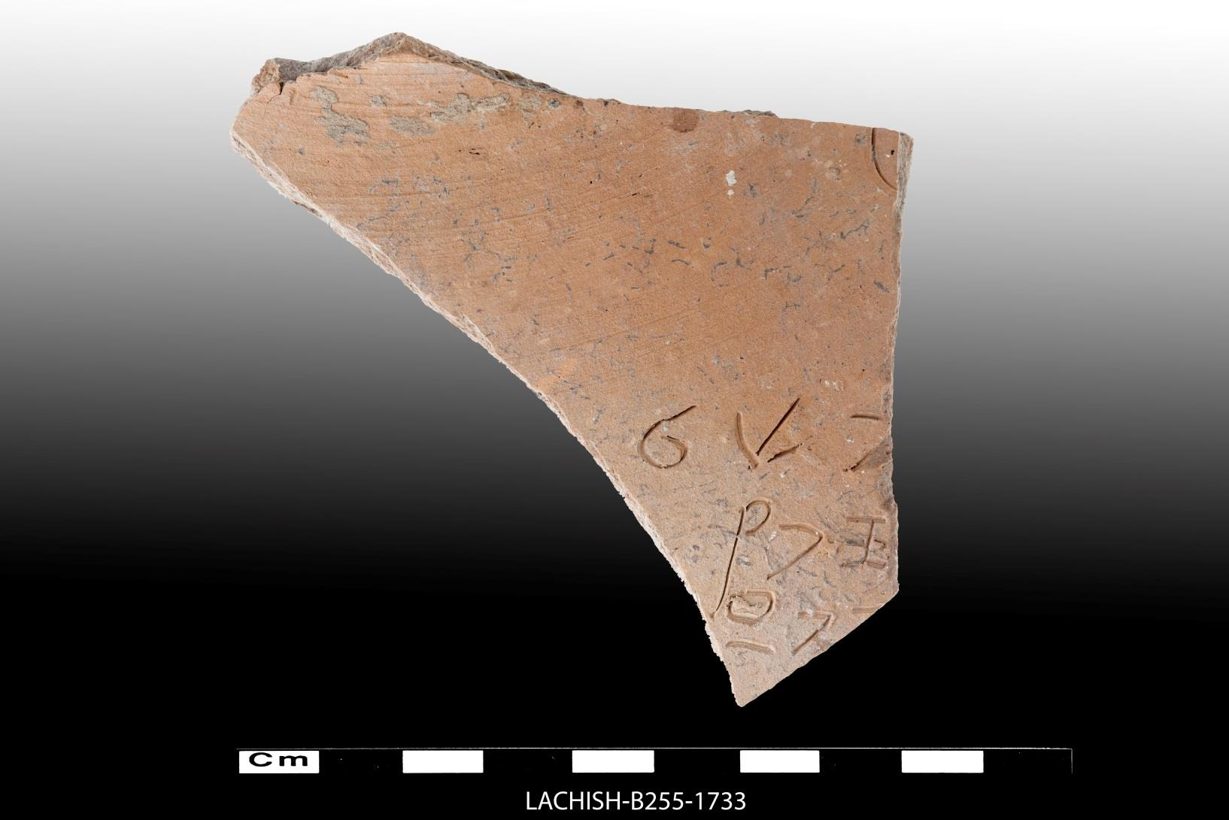
* Finds
Насеченная алфавитная надпись
“The Lachish Ewer”
Fosse Temple III (Lachish - VII)
} פכל {?
} ספר
} XפX {?
Photo by T. Rogovski
* Sass. B., Garfinkel. Y., Hasel. M.G ., Klingbeil, M.G, “The Lachish Jar Sherd: An Early Alphabetic Inscription Discovered in 2014”, BASOR 374 (2015): 233–245
Notes:
Noteworthy – is a sherd with an incised alphabetic inscription
- The inscription was found in the main hall of the temple, and was originally incised on a shoulder of a storage jar.
* Unfortunately - the inscription is too fragmentary to understand what its actually says.
* The inscription was published by – Benjamin Sass, Garfinkel, Hasel, and Klingbeil – and in this article the reading that presented here was suggested.

Slide 22
Gezer
●
Azekah
Kh Qeiyafa
●
●
Socoh
Zayit
Kh. el-Rai
Kh. Summeily
●
●

Slide 23
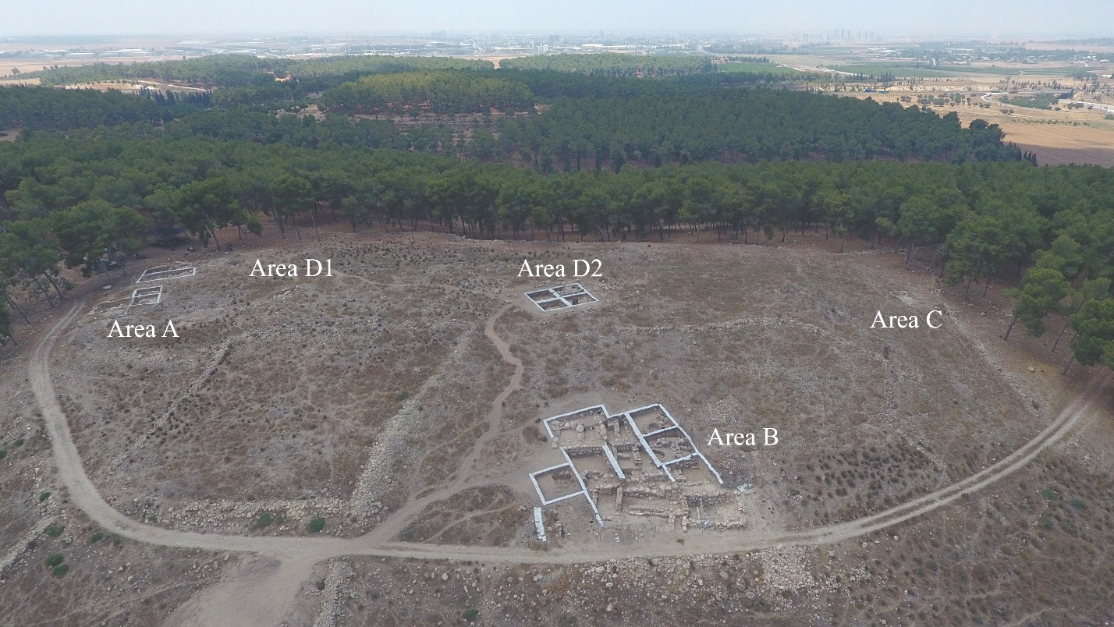

Slide 24
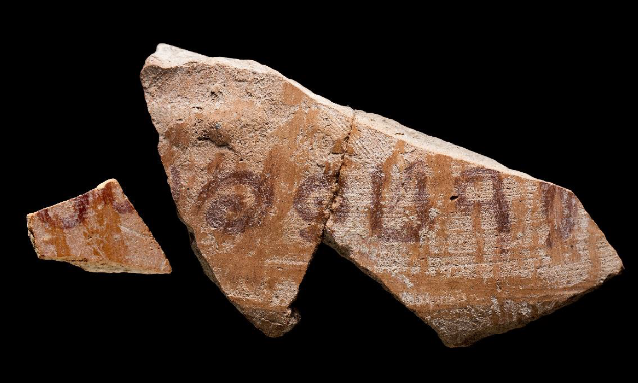
Иероваал
(Гидеон?)
Судей 7:1
Иероваал, он не и Гидеон, встал поутру и весь народ, бывший с ним, и расположились станом у источника Харода; Мадиамский же стан был от него к северу у холма Морé в долине.

Slide 25
Gezer
●
Azekah
Kh Qeiyafa
●
●
Socoh
Zayit
Kh. el-Rai
Kh. Summeily
●
●

Slide 27
№ | Год | Тип | Материал | Место
1 | 1934 | Насечка до обжига | Керамическое изделие (Чаша 1 из Лахиша) | Гробница 527
2 | 1934 | Чернильная надпись | Сосуд (Кувшин из Лахиша) | Храм во рву
3 | 1935 | Насечка после обжига | Керамическое изделие (Чаща 2 из Лахиша) | Район храма во рву
4 | 1936 | Чернильная надпись | Крышка керамического изделия (кадильница) | Гробница 216
5 | 1937 | Гравировка | Бронзовый кинжал | Гробница 1502
6 | 1958 | Чернильная надпись | Маленький керамический черепок | Насыпь, дворец железного века
*7? | 1978 | Чернильная надпись | Чаша | Храм акрополя
8 | 1984 | Чернильная надпись | Керамическая чаша | Яма 3867, уровень VI
9 | 2014 | Насечка до обжига | Сосуд | Пол, северо-восточный храм, уровень VI
10 | 2019 | Чернильная надпись | Чаша с Кипра | уровень С-3
11 | 2021 | Насечка | Гребешок из слоновой кости | Яма, уровень II
12 | 2022 | Насечка | Керамическая чаша | уровень VII

Slide 28
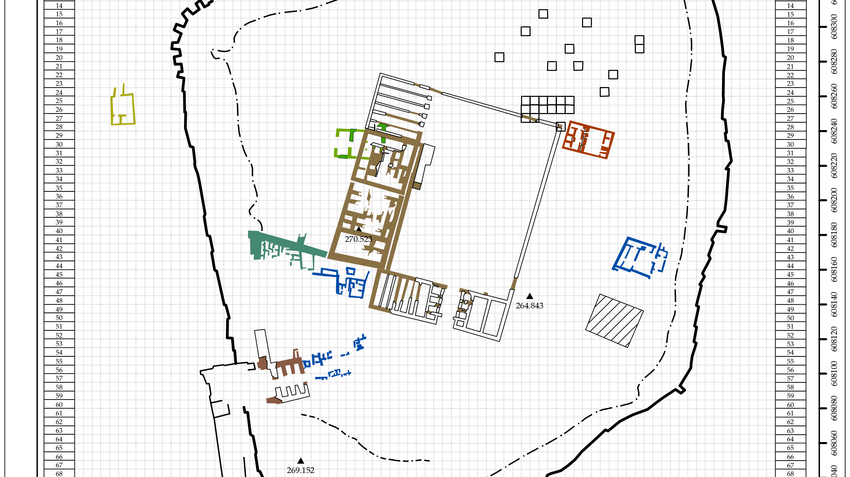
Area AA

Slide 29
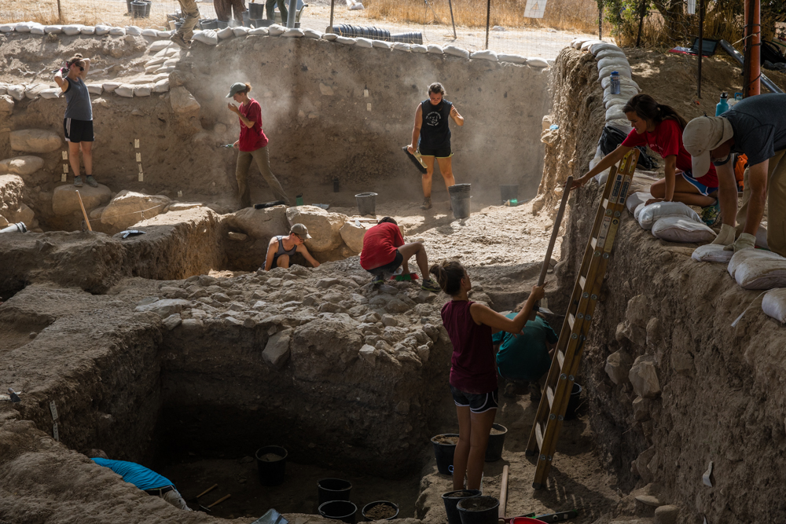

Slide 30
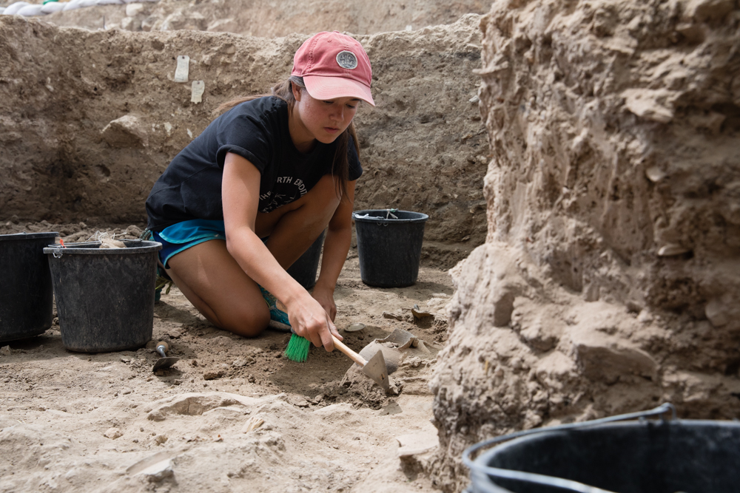

Slide 31
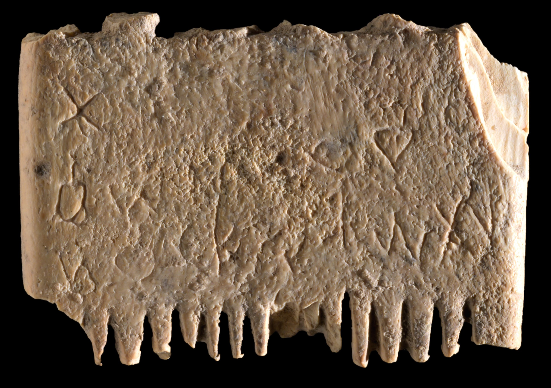

Slide 32
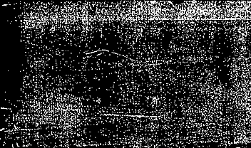
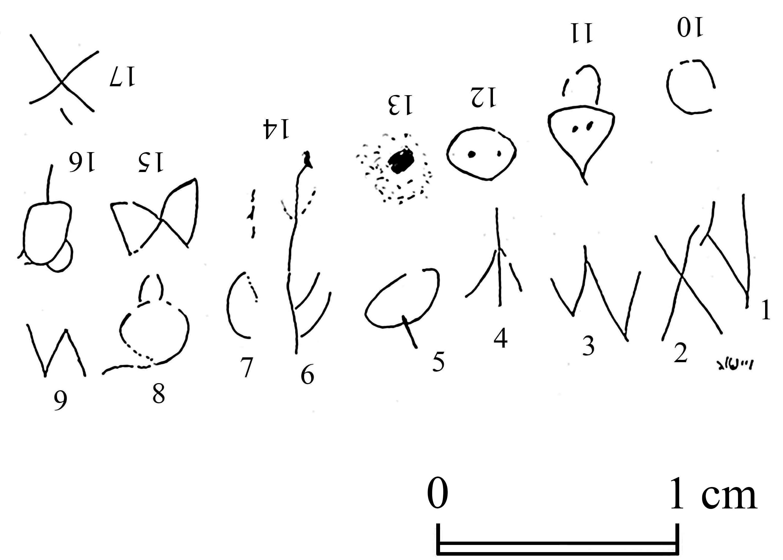

Slide 33
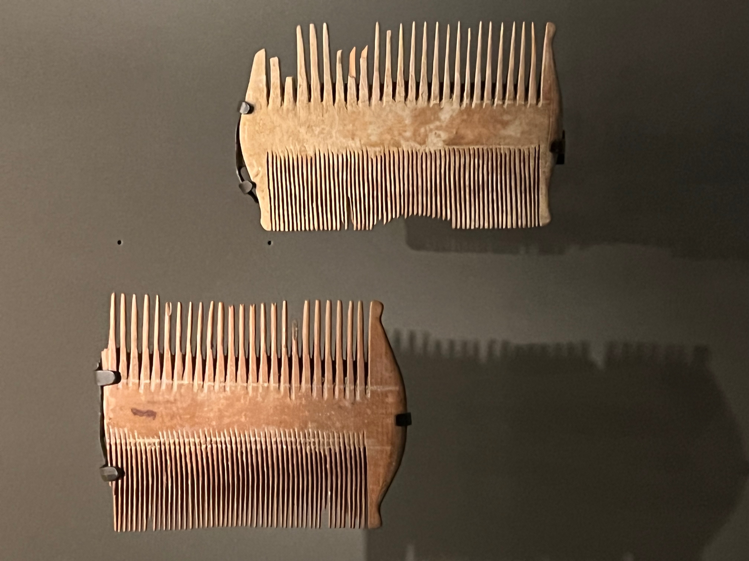

Slide 34
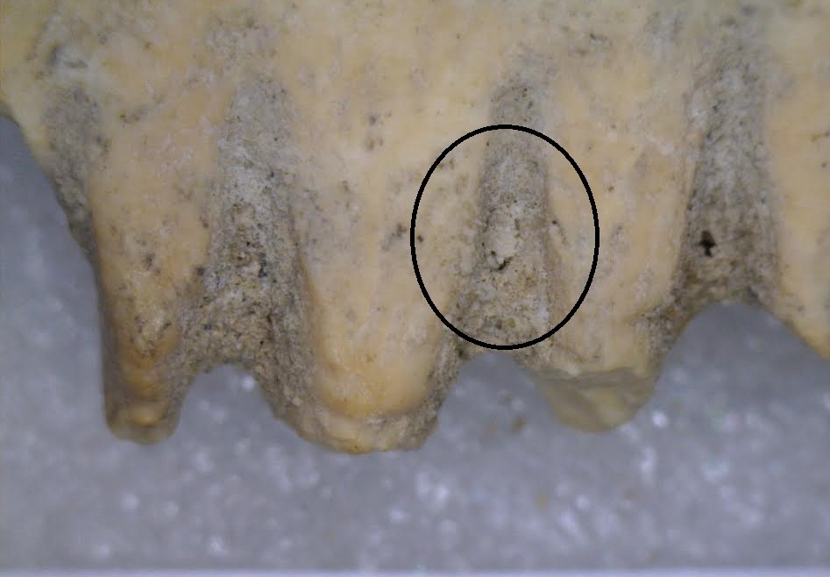

Slide 35
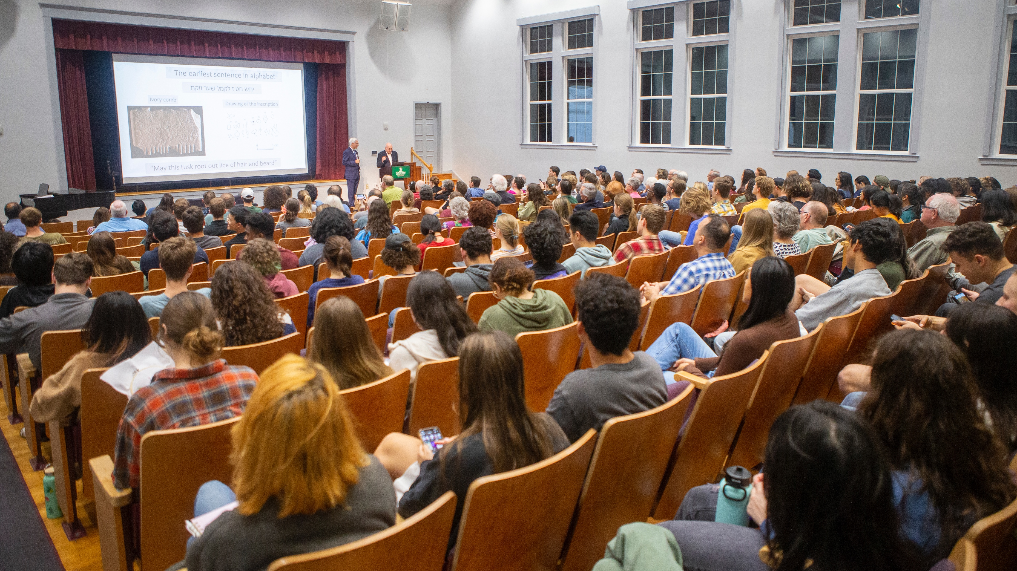

Slide 36
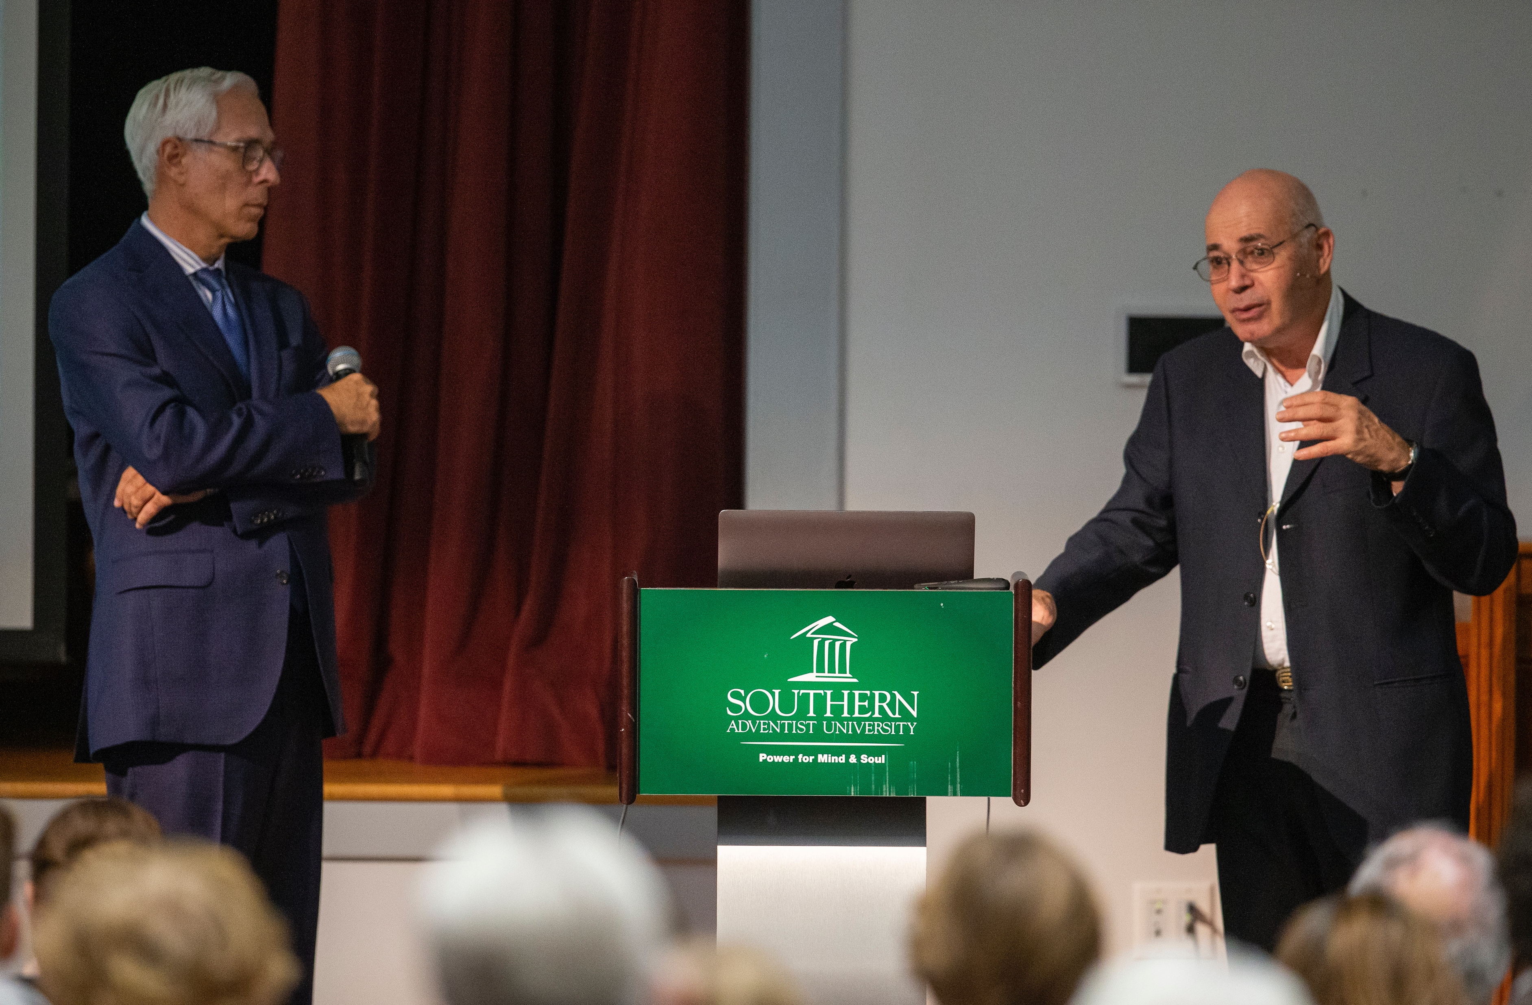

Slide 37
Самое Раннее предложение, напи- санное алфавитным письмом
יתש חט ז לקמל שער וזקת
“Пусть этот клык искоренит вшей из волос и бороды”

Slide 38
Изобретение алфавита
Первое предложение имеет все грамматические элементы предложения — глагол, подлежащее и прямое дополнение, включая один из архаических предлогов прямого дополне-ния, который встречается в еврейском языке
Самые ранние библейские авторы, включая Моисея, имели в своем распоряжении письмен-ную систему, появившуюся, по крайней мере, за 200 лет до Библии
Этот алфавит впоследствии использовался авторами, писавшими на еврейском, арамейском, финикийском, греческом и латинском языках, а также всех европейс-ких языках, используемых миллиардами людей

Slide 39
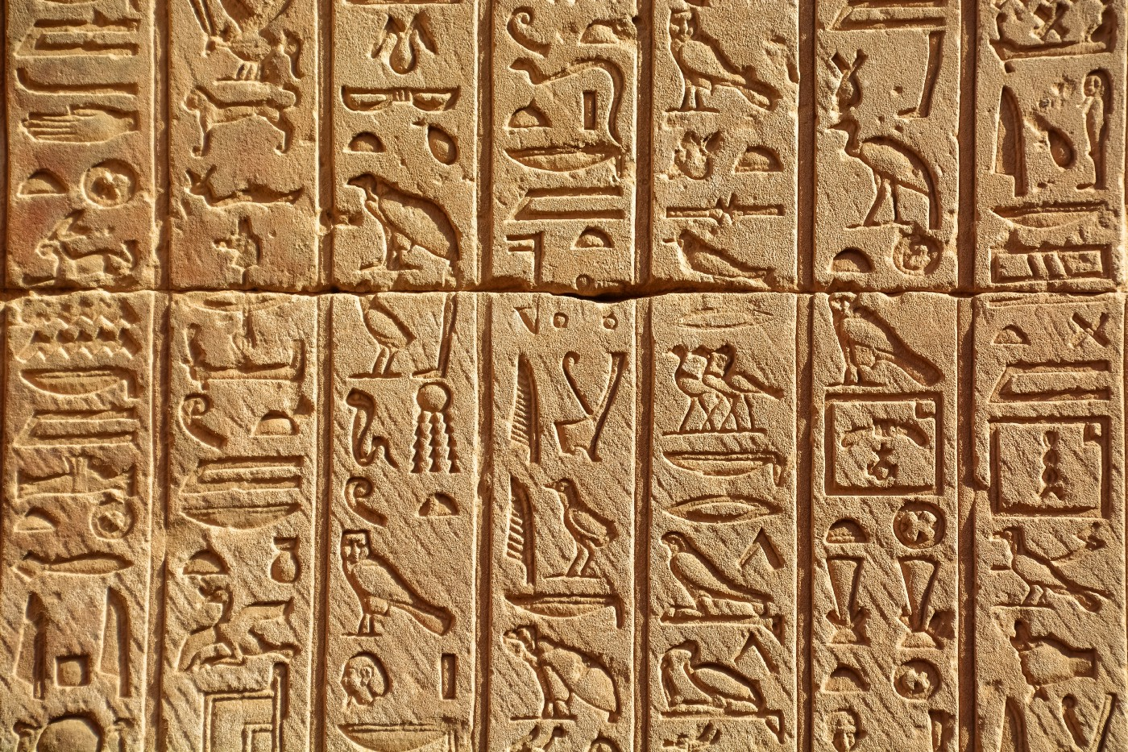

Slide 40
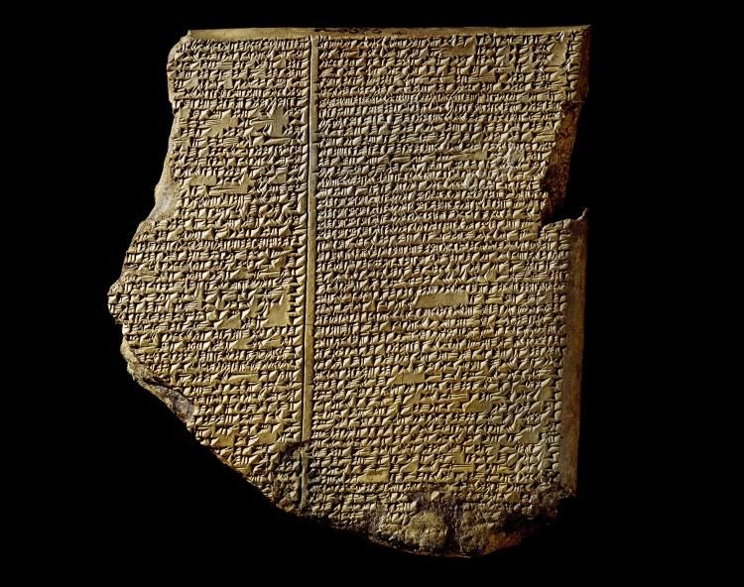

Slide 41
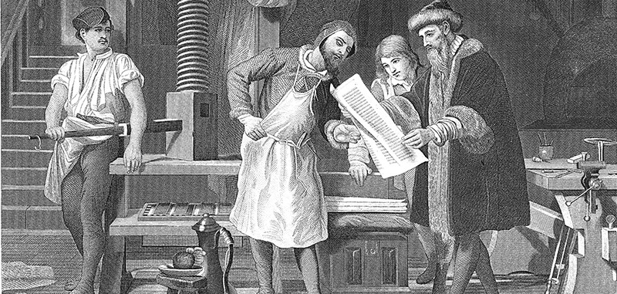

Slide 42
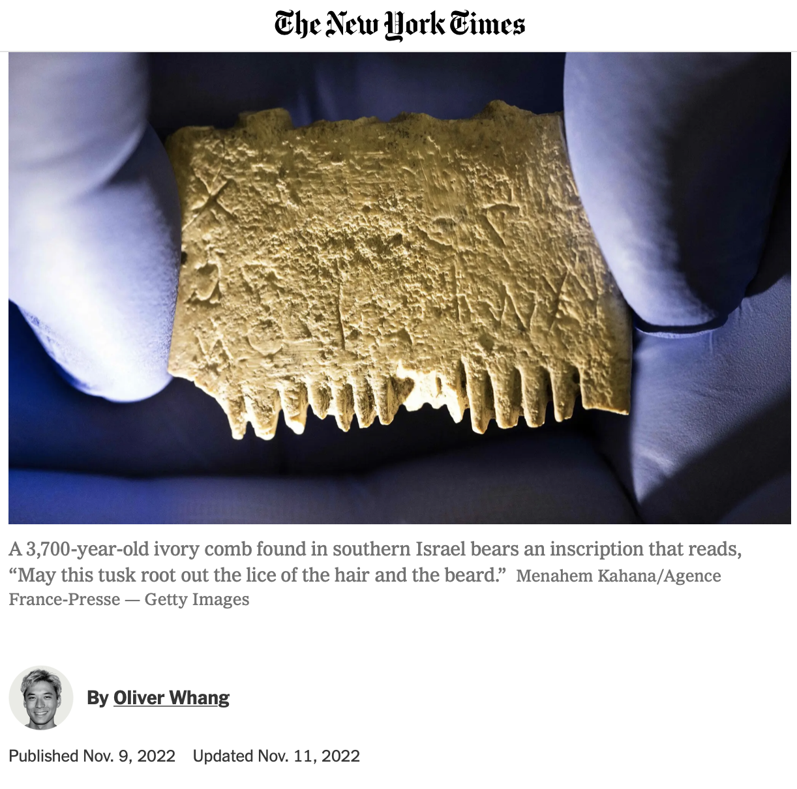

Slide 43
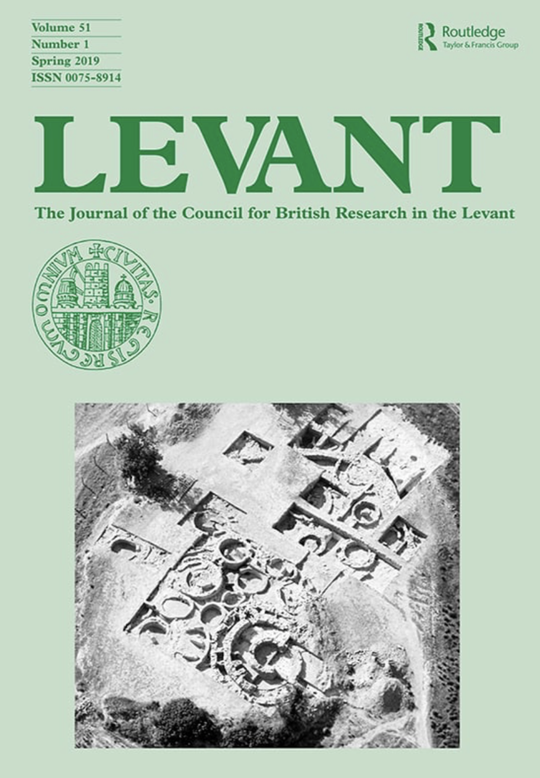
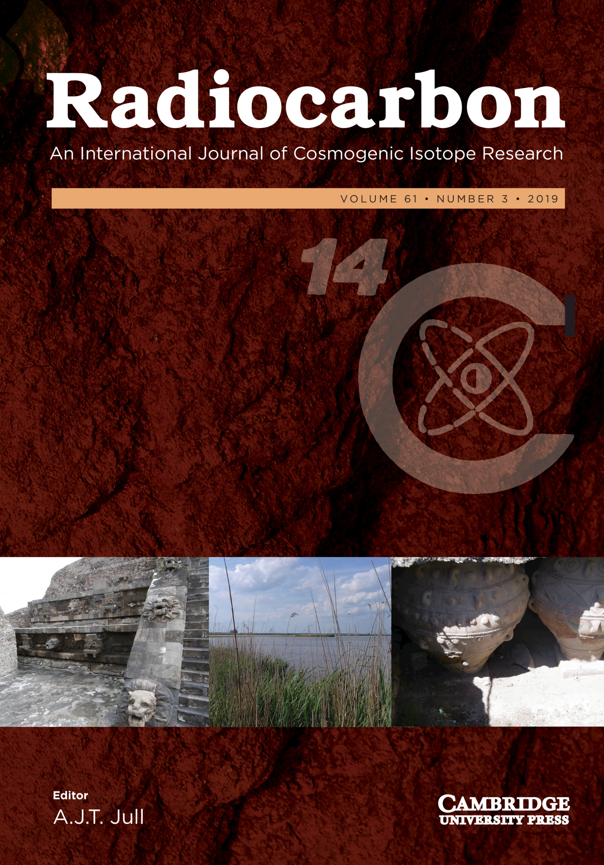
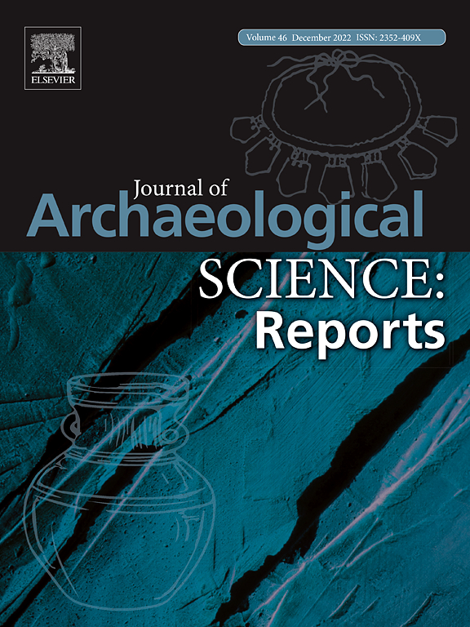

Slide 44
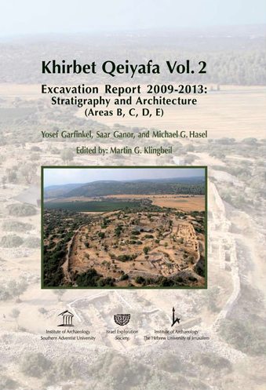
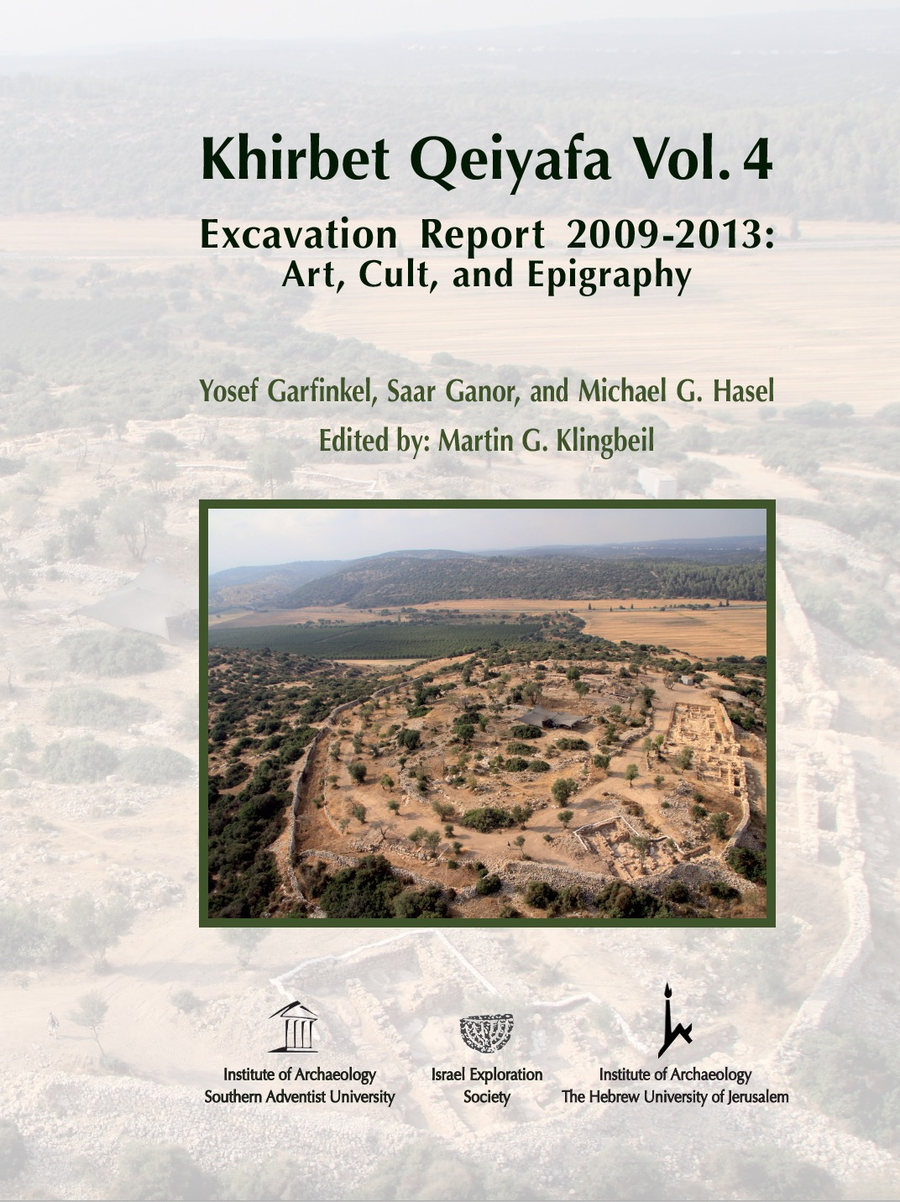
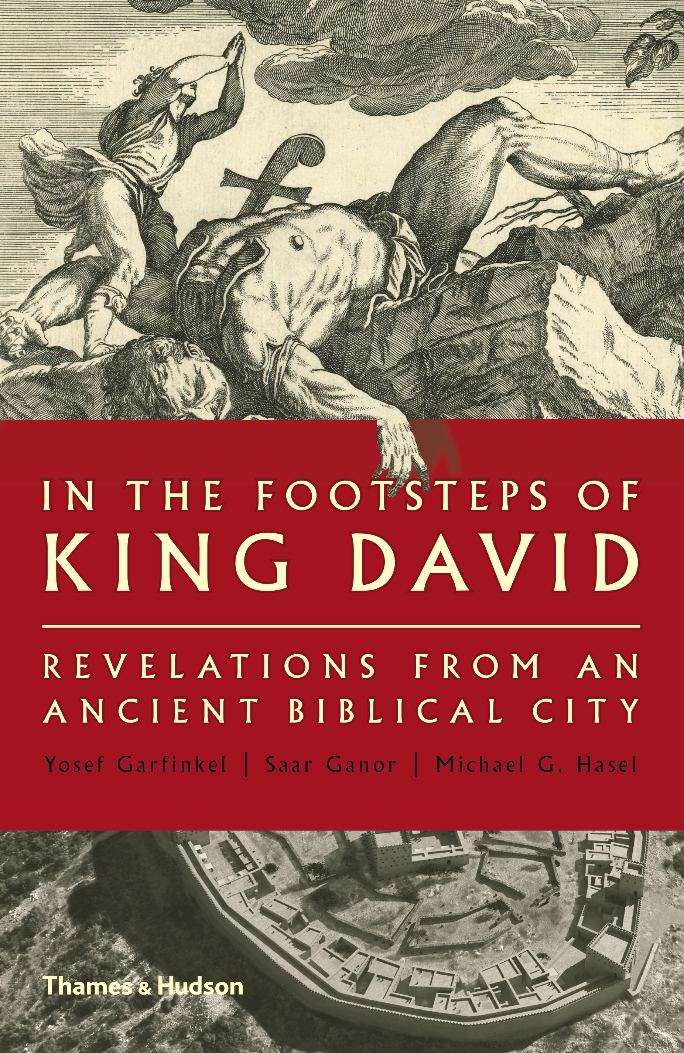
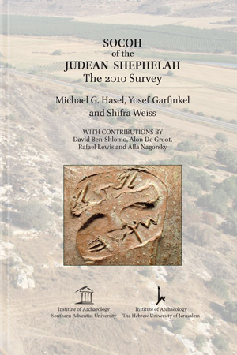

Slide 45
Notes:
Why do we come to Scripture? We come to seek God, yes. But we also come to seek truth. We cannot seek something that we do not believe exists. Or let me state that differently. To reach a goal, you must believe that the goal is attainable. Faith is required for the race of life that Paul speaks of. But the race is not an imaginary thing. Nor can it go endlessly in circles. It must have a direction. The race of faith is based on real life circumstances. It is set in a historical reality and the nexus of time and place. This is what makes Biblical faith unique among the ancient and modern religious/philosophical models. The Bible is constituted in a historical living reality of life as experienced and recorded through the history of this world. From Adam to the promised Messiah, from the Resurrection, which we celebrated a few weeks ago, to the Second coming. Biblical faith has a purpose, a goal, and a mission. It is forward moving. It is based on a God who is not distant and removed, but one who spoke and then formed man from the dust of the ground and breathed into Him the breath of life. A God who intricately fashioned Eve and provided for the first partnership in human history. It is based on a God who sent His son into this world. The ultimate act in human history was that act of infinite love that poured out a life to give life. This is why we can have hope. This is why we can have peace in the midst of the storm. Jesus said, in John 16:33: “These things I have spoken to you, so that in Me you may have peace. In the world you have tribulation, but take courage; I have overcome the world.”
So How then did we end up with the Bibles we read today? How did the 35-40 writers of Scripture become those writes and how did their books come to form the collection that we have today? How do the Bibles we read relate to what Moses, David, Solomon or any other person wrote? What was the process involved?

